Slide 1
Marketing Camping Analysis Home Work 2
Team mates:
Ajay Mishra
Shipon Nath
Michel Ngoye
Ilona Inchenko
Arina

Slide 2
Data Preparing
The key indicators chosen for measuring the effectiveness of the email campaign are the following:
the open rate
click rate
click to open rate
conversion rate
We will calculate first the open rate by dividing the number of customers who opened the email to the number of customers who got the email. Since we have in our data a difference between sent and delivered, we are going to calculate:
nbr of customers who opened the email / sent
nbr of customers who opened the email / sent and delivered

Slide 3
Funnel

Slide 4
So we can say the Popup is better then the email

Slide 5
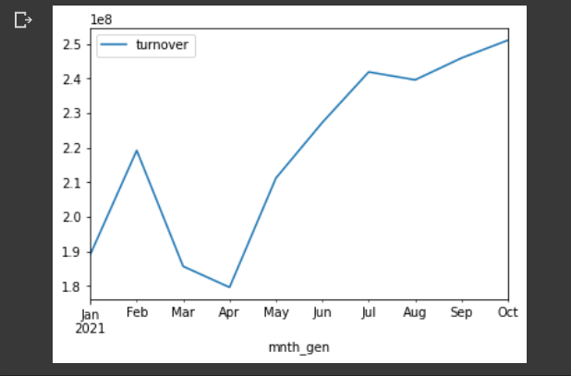
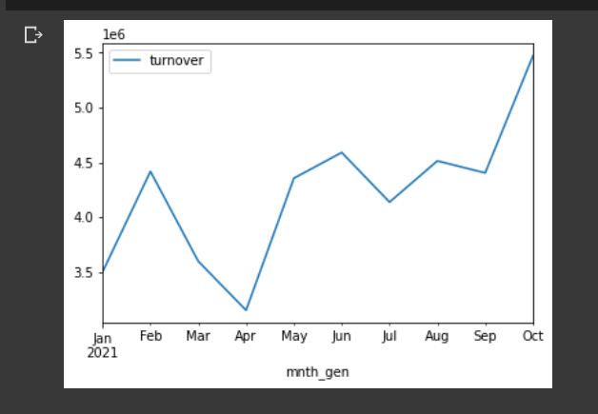
Email and Popup camping test
Email Camping
Popup camping

